Slide 1
Block Trade
Revolutionary Duo Of Supply Chain And Blockchain Technology
Supervisor: Dr. Sufian Hameed
Abdul Sami 17K-3700
Armughan Ahmed 17K-3696
Muhammad Farhan 17K-3945
Date: 22-10-2020

Slide 2
Overview
Initial Delivery Expected
December, 2020
Contents
Supply Chain
Main challenges
Defining the problem
Solution
Blockchain
Documents
Features
Participants
Architecture
System Flow
Eco system
Benefits
SWOT analysis
Schedule

Slide 3
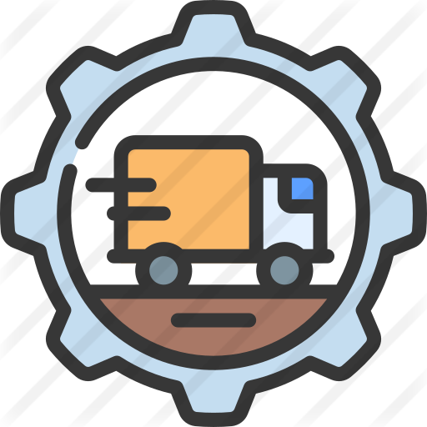
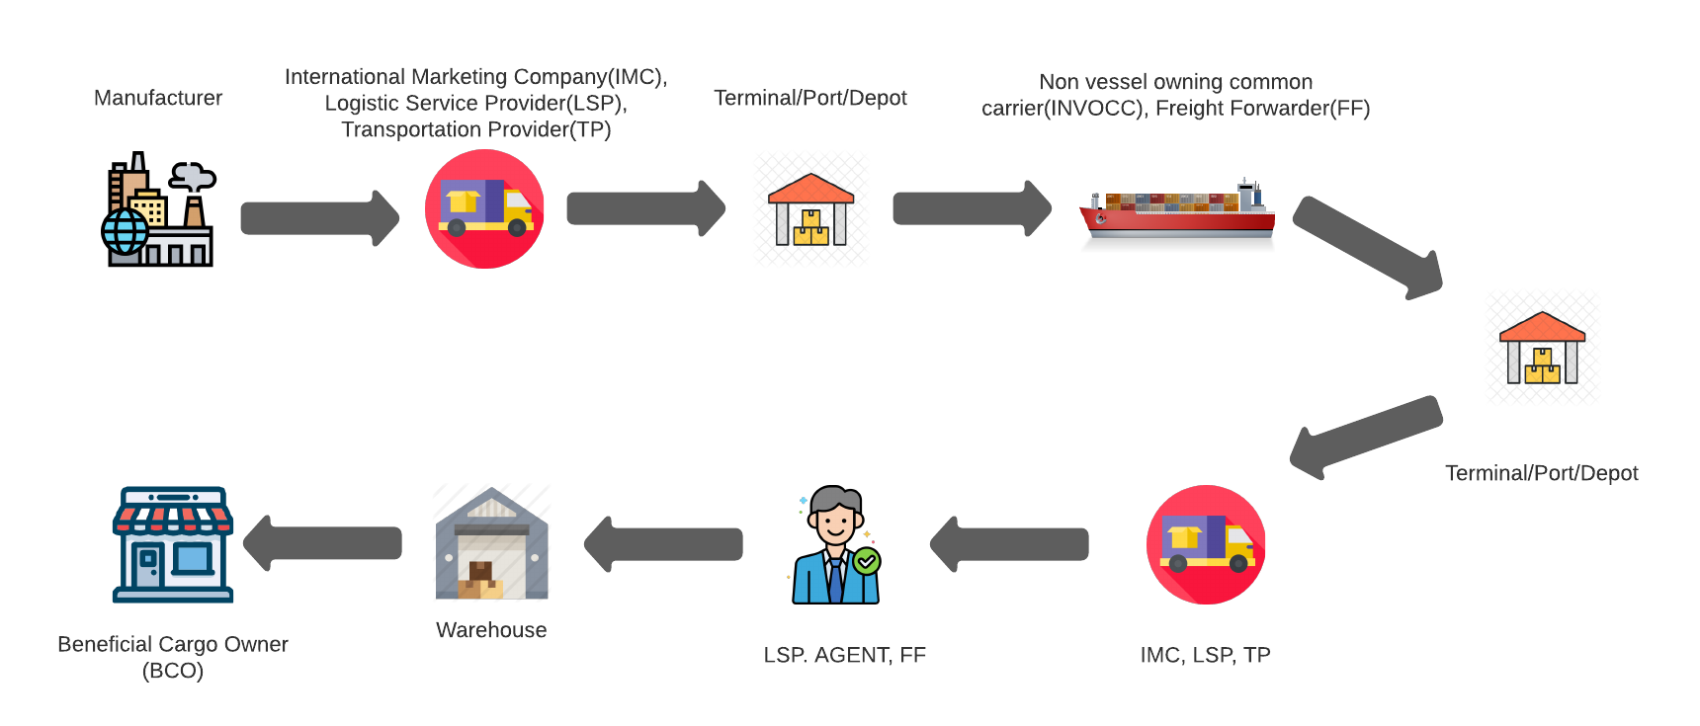
Supply Chain ?
The flow of a good or service — starting from the raw components all the way to delivering the final product to the importer.
This includes a network of suppliers (the “links” in the chain) that move the product along from the suppliers of raw materials to the organizations who deal directly with users.

Slide 4
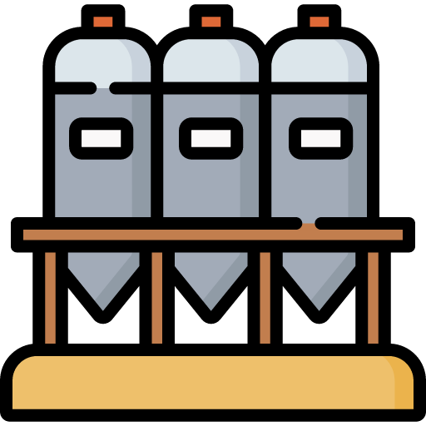

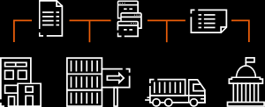



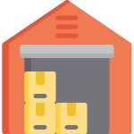
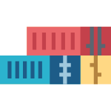

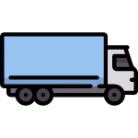
Main Challenges
Data is trapped in organizational silos
Critical shipping data is held on various paper and digital systems. Inconsistencies, delays and blind spots lead to poor decision-making.

Slide 5
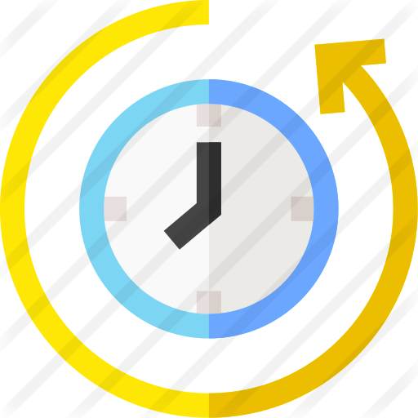


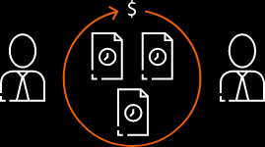



Main Challenges
Processes are time-consuming
Manual follow-ups result in inconsistent exception handling and audit procedures. High compliance costs often follow.

Slide 6



Main Challenges
Clearance is subject to delays
Customs clearance involves high levels of risk assessment to prevent fraud and forgery, which often leads to shipment delay.

Slide 7



Defining the problem
Million and billions of packages are shipped everyday internationally.
Maintaining a record of these trades, granting access to specified authorities, security and transparency seems near impossible.
Extra costs due to delays, extra safety measures and friction increases the added value of the product.
Many people avoid selling their goods internationally due the risk of fraud and fear because of no control on the goods being shipped.
Securing the documents from hackers and keeping it hidden from the competitor seems very hard.
Proving the authenticity of the document is also a time consuming task and thus adding more time to the delivery.

Slide 8
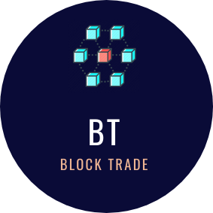
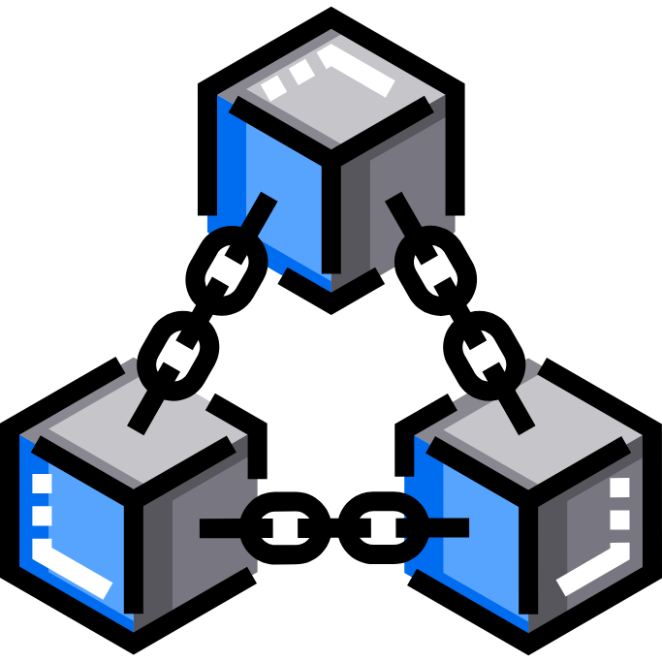

Solution?

Slide 9
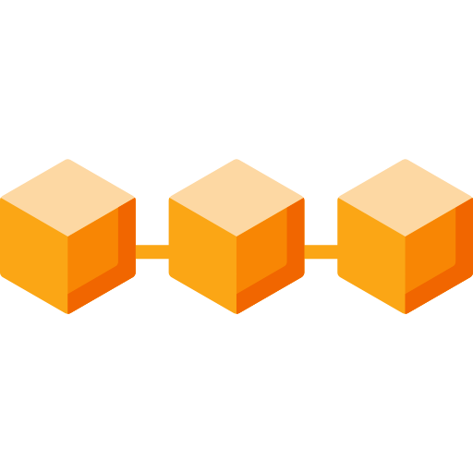
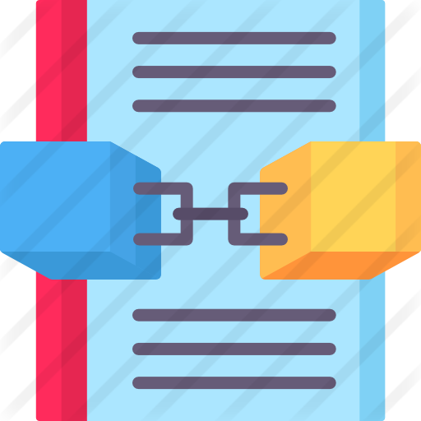
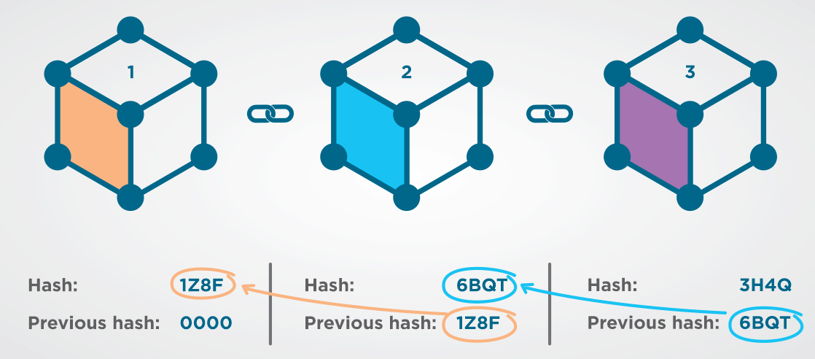
Blockchain ?
Blockchain is a distributed ledger of continuously growing data in chain order in which each block is secured using cryptographic algorithms.
Blockchain is an immutable ledger where transactions can only be added and viewed.

Slide 10


DOCUMENTS
Accessible, immutable and auditable documents simplify trade workflows and speed up processing.
Document handling provides seamless role-based access to structured and unstructured consignment information for all supply chain partners.
Parties to the consignment can be notified when relevant documents or document amendments are published.

Slide 11

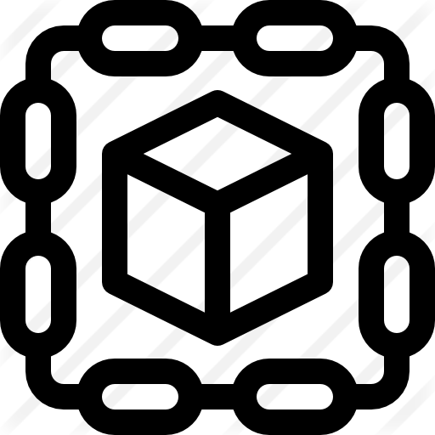
BLOCKCHAIN
The digital document workflow is simplified with a single, agreed and tamper-proof source of truth.
Block trade uses blockchain technology to guarantee the immutability and traceability of shipping documents on the platform.

Slide 12
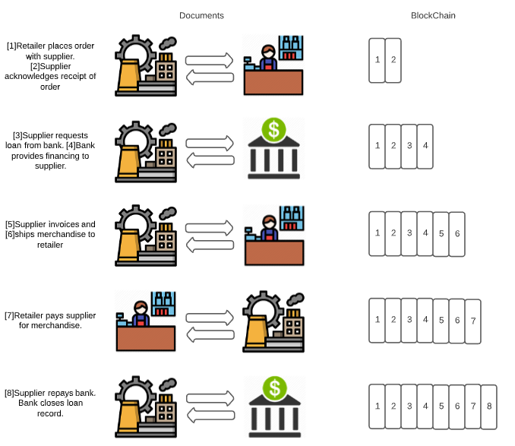
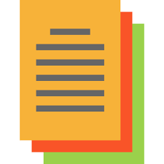
Adding Documents in Blockchain

Slide 13

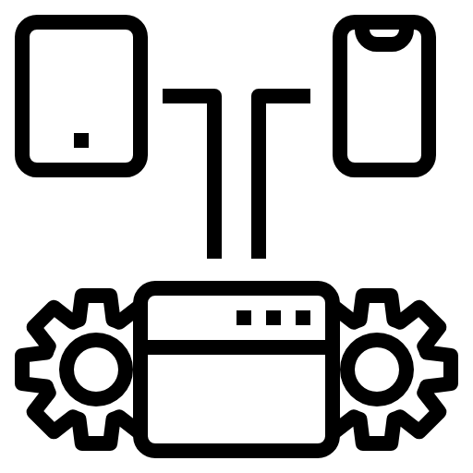

Features in our system
We plan to bring all the authorities, organizations, carries, banks and freight forwarders on a single platform.
Exporters can view the record and select the best or the cheapest carriers reducing the risk of safety
Blockchain based system of document storing.
Tracking of the shipped goods when they arrive or leave any location.
Custom clearances made easy.
Discharging of the shipment in one click.
Best insurance providers and transport service providers.
Email Notifications

Slide 14


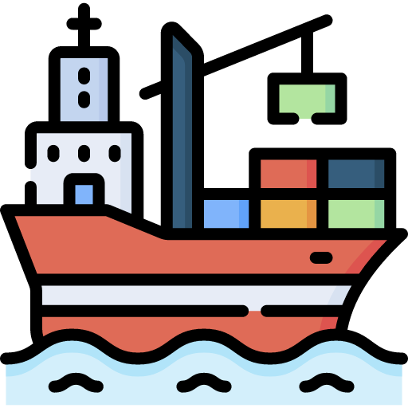
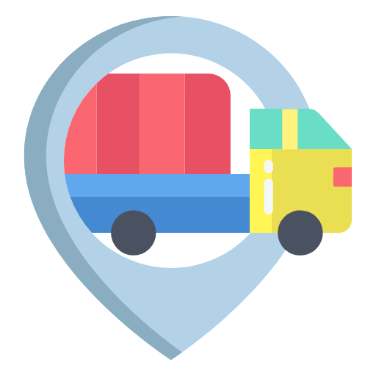


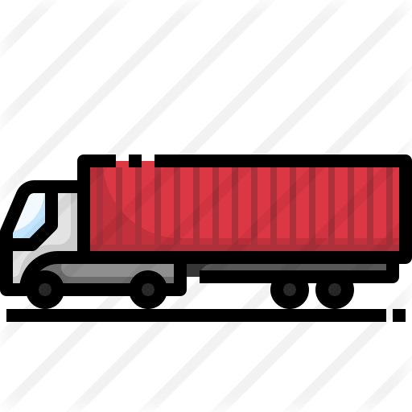
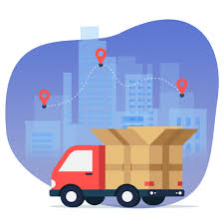
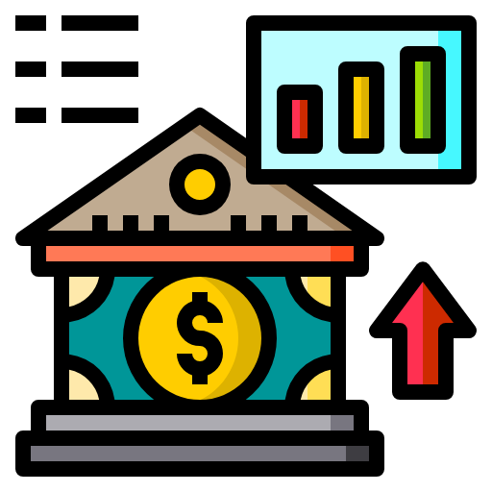



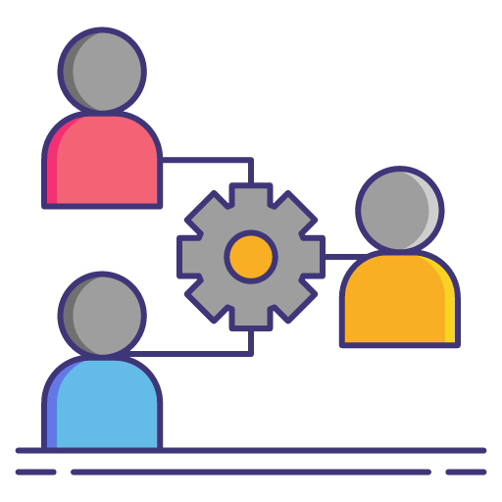

Participants
Cargo interests
State Agents
Truck Operators
Transport Provider
Rail Operators
Third Party Logistics
Ocean Carrier
Terminal Operators
Custom Authorities
Banks
Port Authority
Financial Institutions

Slide 15
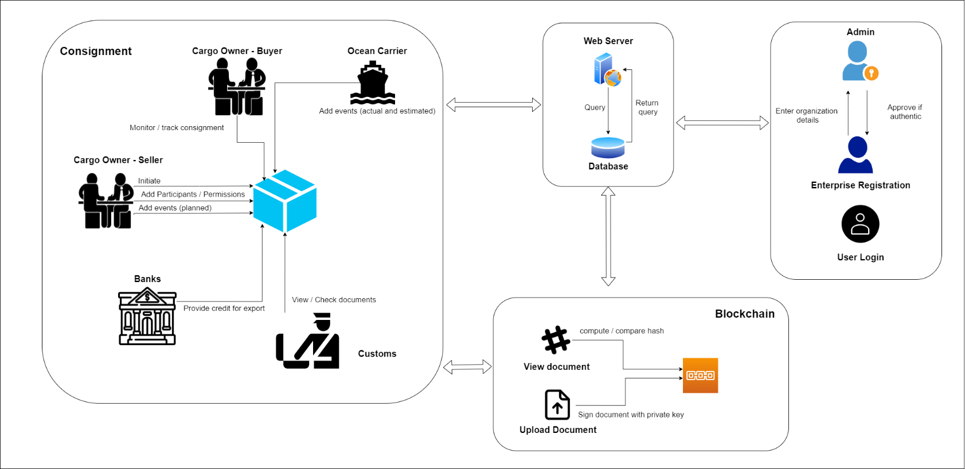
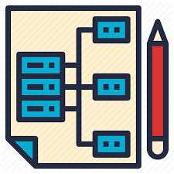
System Architecture

Slide 16
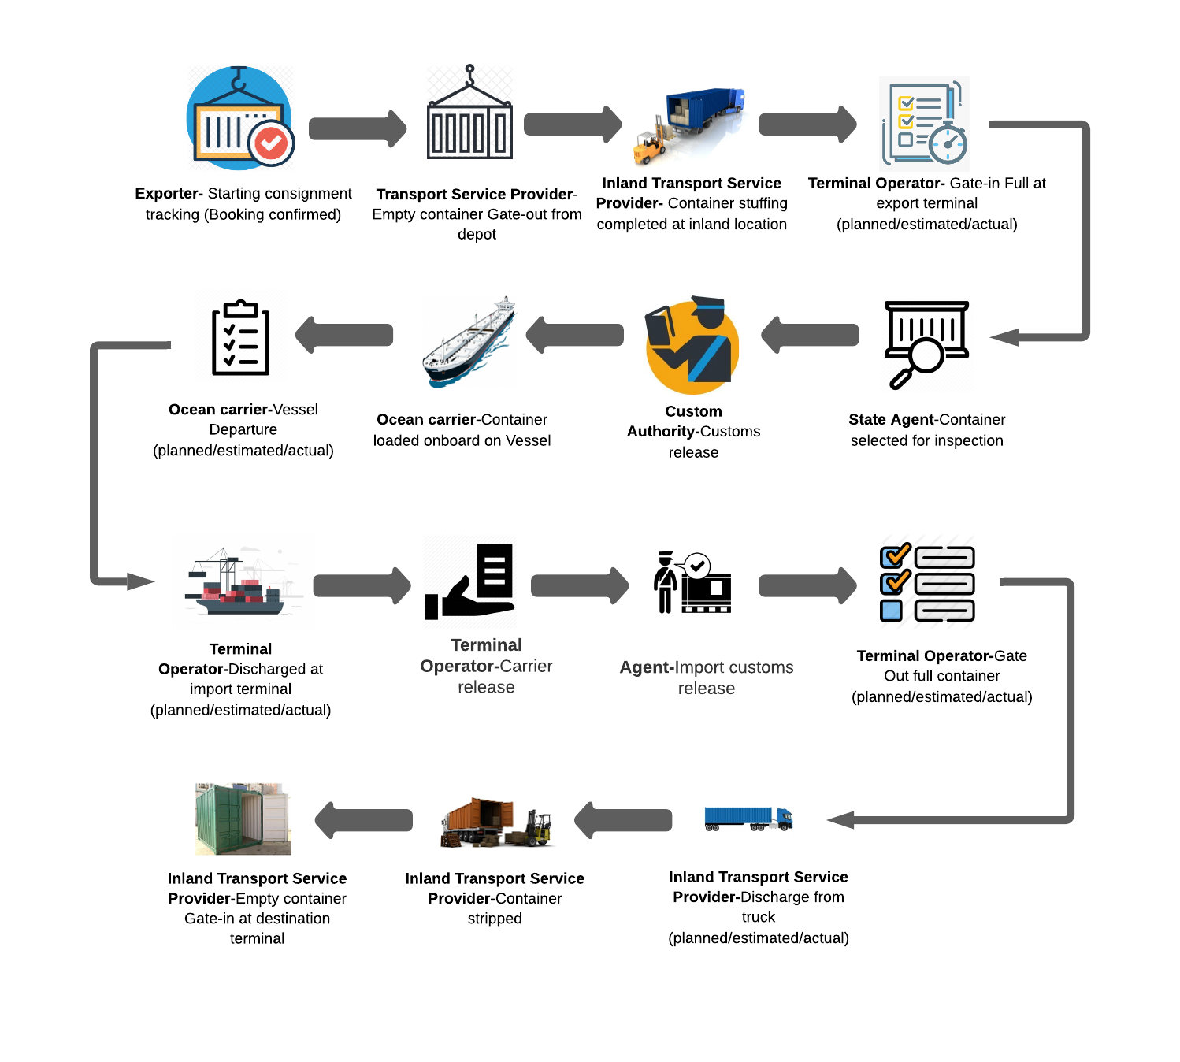

System
Flow

Slide 17
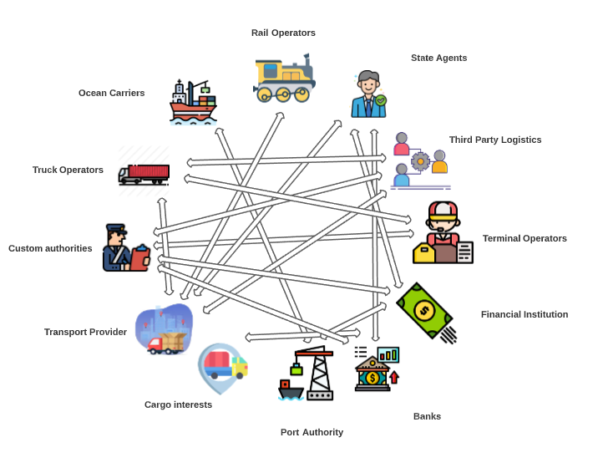

Supply Chain

Slide 18
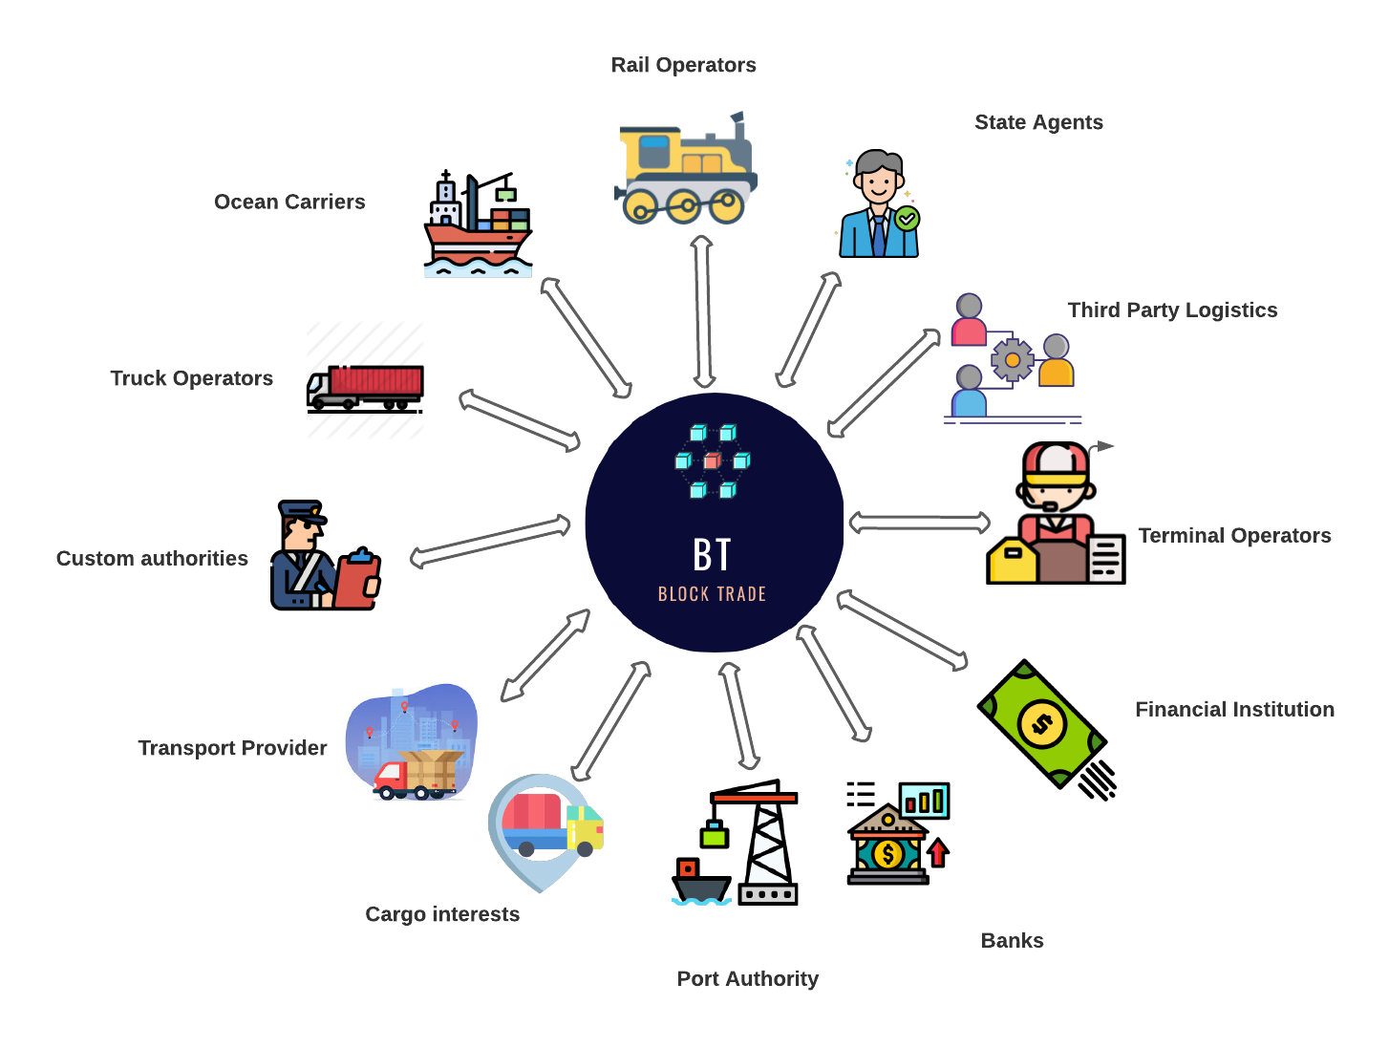
Block Trade
Eco System

Slide 19

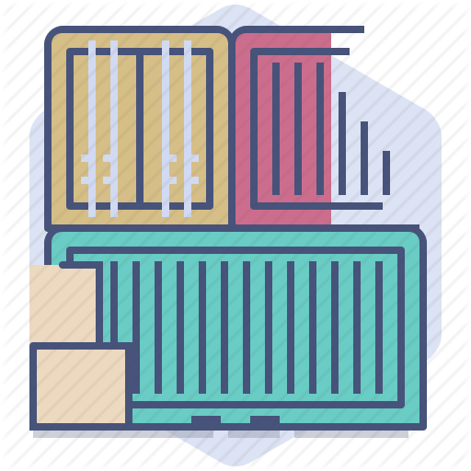

Benefits
For Exporters:
Eliminate manual process
Improved efficient document handling
Easy custom process by providing document authenticity
For Authorities:
Reduced manual paperwork
Greater visibility and transparency

Slide 20
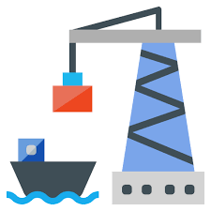
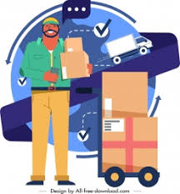
Benefits
For Ports:
Eliminate manual process
Event data around authority activities will be received more quickly
Shorter queues at the port
For Freight forwarder/3PL:
Reduces time for paperwork errors
Clear audit trails make easier to avoid problems

Slide 21
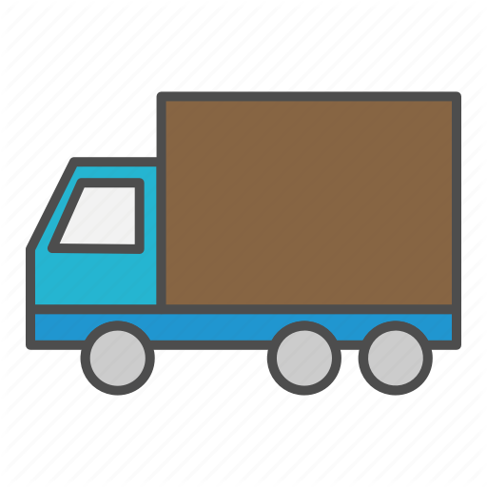
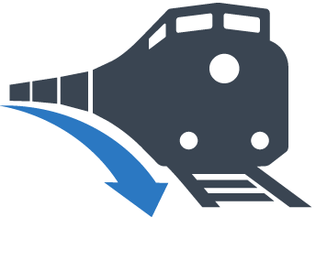
Benefits
For Intermodal (Trucking):
Visibility of event data
Reduced waiting time due to better yard planning
Shorter queues at the port
For Intermodal (Rail):
Digital documentation reduced the complexity of custom process.
Decreasing process time

Slide 22
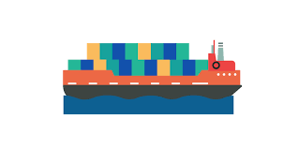
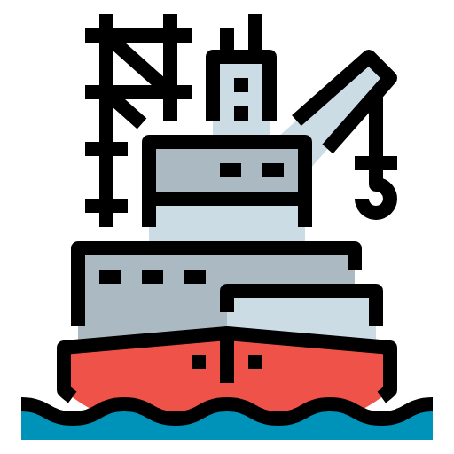
Benefits
For Ocean carriers:
Increased flexibility to connect with new providers
Increased safety due to immutable records
For Feeder:
Booking information available in real time
Digital confirmation eliminates manual processes

Slide 23
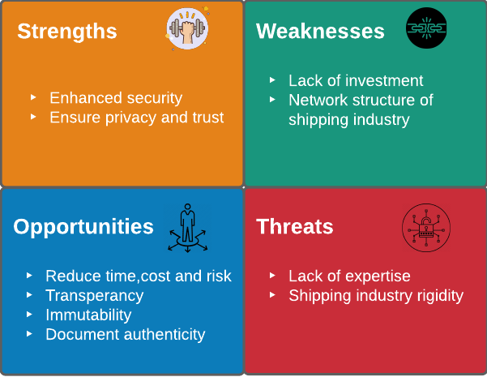
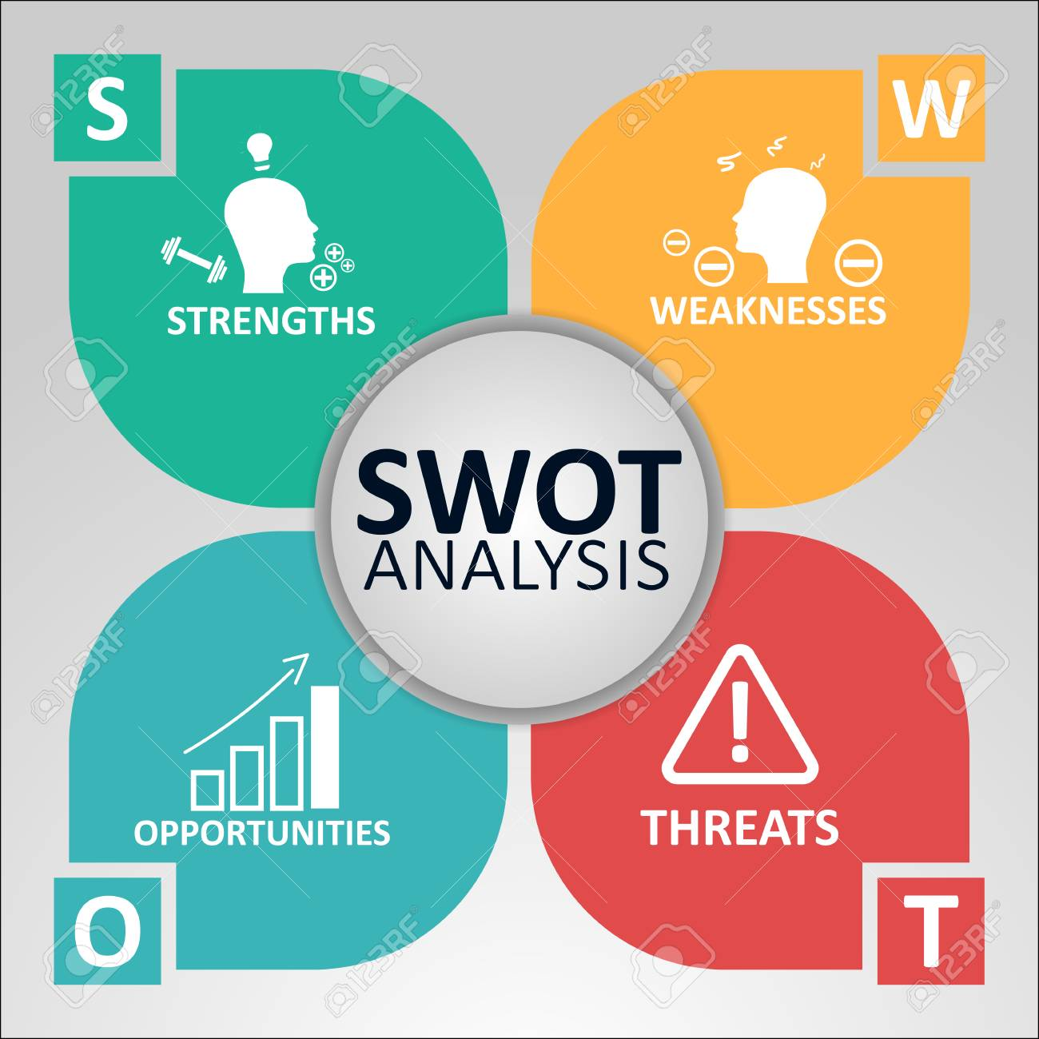
SWOT Analysis

Slide 24
Schedule

Slide 25
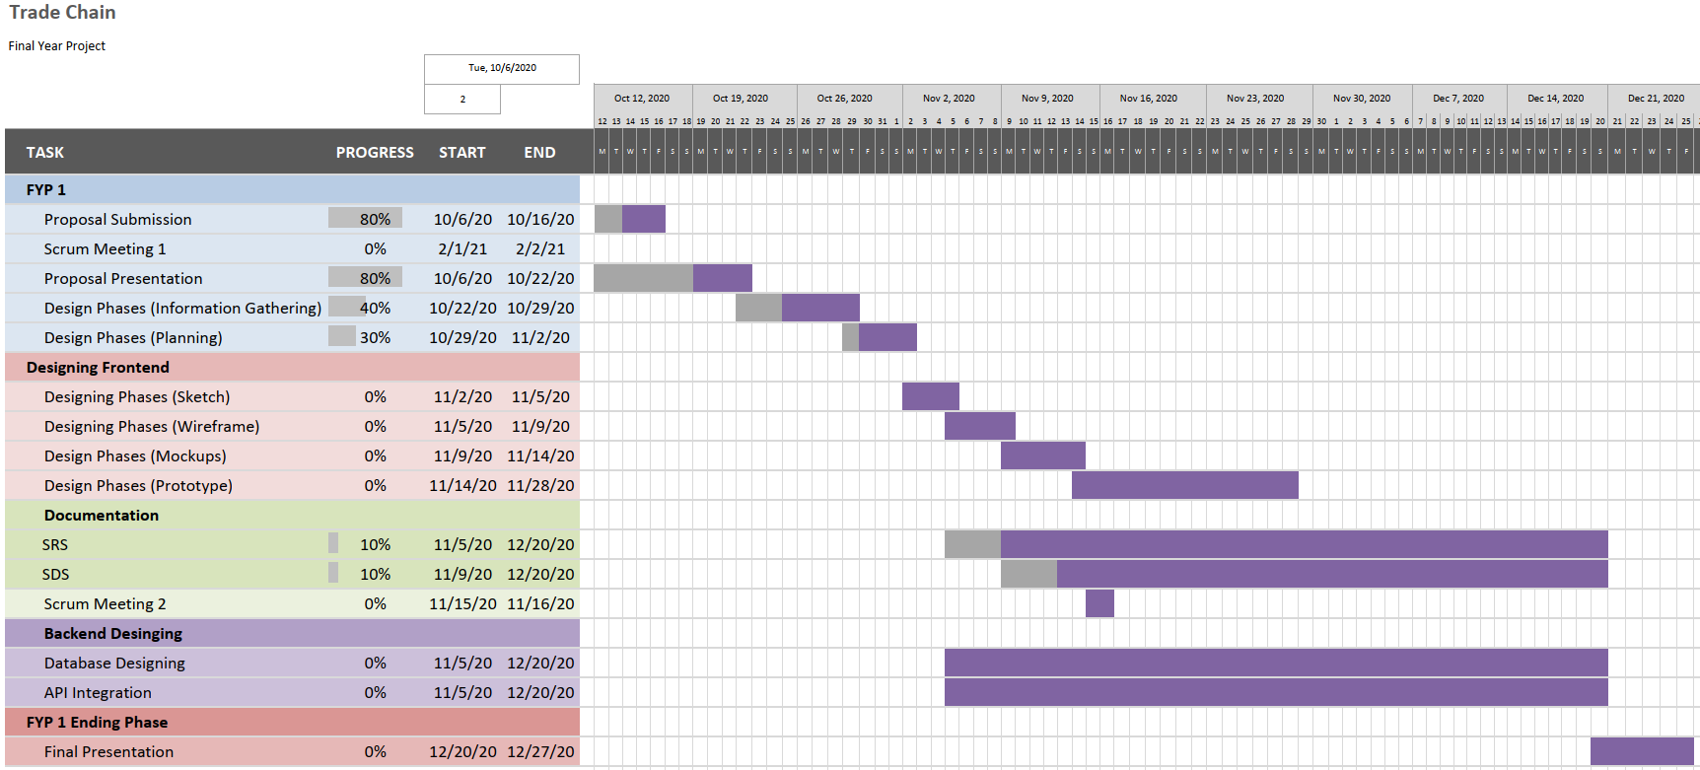

Slide 26
